Slide 1
PHYSIOLOGY OF CSF AND PATHOPHYSIOLOGY OF HYDROCEPHALUS

Slide 2
Introduction
Dynamic component of CNS
Invaluable tool to diagnosis
Physiological reservoir of human proteome
Reflects the physiologic state of CNS

Slide 3
Historical account
Hippocrates described fluid in brain
Galen described ventricles
Vesalius showed the anatomy
Megendi performed first cisternal puncture in animals
Quinke performed first LP
Dandy was credited first ventricular puncture
Quekensted did first cisternal puncture in humans.

Slide 4
Functions of CSF
Mechanical cushion to brain
Source of nutrition to brain
Excretion of metabolic waste products
Intracerebral transport medium
Control of chemical environment
Autoregulation of intracranial pressure

Slide 5
Production of CSF
Choroidal
Extrachoroidal
Ependyma
? Neighboring brain substance
Notes:
In children with foramen of megendi and lushka block, spinal thecal sac still is bathed in CSF.
choroid plexectomy does not releieve hydrocephalus.

Slide 6
Facts of interest
Only choroidal CSF production is tightly regulated active process
CSF secretion shows diurnal variation with peak in the morning.

Slide 7
Factors affecting production
Vascular bed autoregulation
Intracranial pressure
Brain metabolism
Drugs

Slide 8
Absorption of CSF
Arachanoid granulations
Along the olfactory nerves
Extracellular spaces in brain
Brain substance ( glial cells).

Slide 9
Factors affecting absorption
Intracranial pressure

Slide 10
Quantitative dynamics
Daily secretion:
Total CSF volume:
Ventricular
Cisternal
Spinal

Slide 11
Techniques of CSF analysis
Lumber puncture
Cisternal puncture
Ventricular puncture

Slide 12
Lumber puncture
Diagnostic indications:
Infective pathology
Inflammatory pathology
Subarachanoid hemorrhage
Malignancy and spread
Pressure recordings
Cisternography, myelography,
Therapeutic indications:
CSF drainage
Drug delivery

Slide 13
Contraindications
Absolute
Posterior fossa mass
Coagulopahty, blood dyscrasias
Known spinal AVM
Relative
Raised ICT (guarded LP)
Local infection

Slide 14
Technique
Positioning
Cleaning and draping
Puncture
CSF

Slide 15
Complications
Post LP headaches
Hematoma
Infection
Neural injury
Iatrogenic dermoids

Slide 16
Other methods
Cisternal puncture
Lateral cervical puncture
Ventricular puncture

Slide 17
Ventriculostomy
Dandy`s point
Keen`s point
Frazier`s point
Kocher`s point

Slide 18
Analysis
Glucose | 60-90 | ≥ 0.66
Proteins | 35mg/dl | 0.005
globulins | 10-50 mg/L | 0.001
RBC | 0-1
WBC | 0-1 (L)
Lactate | 1.6 | 1.6

Slide 19
Diagnostic characteristics
Type | Sugar | Cells | Lactate
Bacterial | Very low | Neutrophils | Increased
Fungal | low | L/N | -
Viral | Normal to low | L/N | -
Aseptic | Normal | Neutrophils | Normal
Post operative | Normal | Neutrophils (≥1000)

Slide 20
Hydrocephalus
Definition
Imbalance between production and absorption of CSF leading to accumulation of fluid in the ventricular system leading to elevation of intracranial pressure.

Slide 21
Epidemiology
Infantile HCP: 3-4 per 1000 LB
As a single congenital disorder: 0.9-1.5 per 1000 live births
Associated with SD: 1.3-2.9 per 1000 LB

Slide 22
Classification
Communicating
AKA extraventricular,
Noncommunicating
AKA obstructive
Triventricular
Biventricular

Slide 23
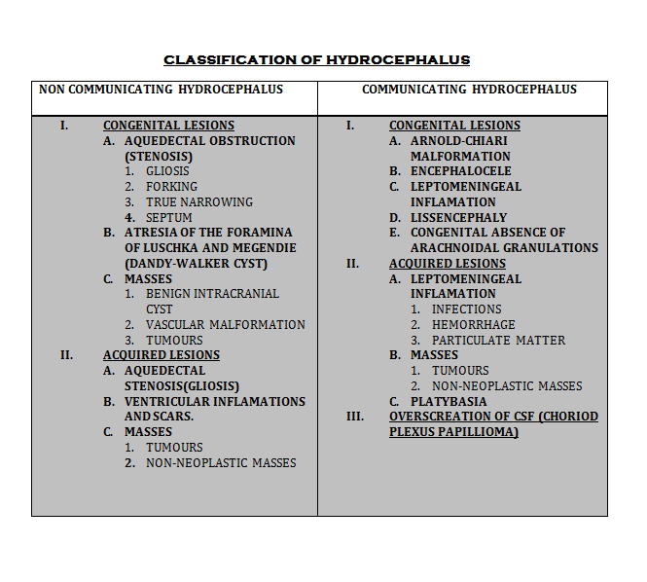

Slide 24
Pathogenesis
Obstruction of CSF pathways leading to decreased absorption
Increased production
Increased venous pressure

Slide 25
Increased production
Choroid plexus papilloma

Slide 26
Decreased absorption
Due to anatomical block in the pathways
Block at arachanoid granulations level

Slide 27
Increased venous pressure
Evidence with this theory
VOGM
Experimental studies in animals
Evidence against this theory
Ligation of various sinuses doesn’t cause HCP
Experimental studies

Slide 28
Pathology of hydrocephalus
Atrophy of white matter
Spongy edema of brain
Fibrosis of choroid plexuses
Stretching and denuding of ependyma
Fenestration of septum pellucidum
Thinning of interhemispheric commisures

Slide 29
Acute HCP
Cerebral, IV or cerebellar hematoma
Paraventricular tumors
Gunshots
Subarachanoid hemorrhage
Acute head injuries
Shunt malfunction.

Slide 30
Progression
Ventricular dilatation
Occipital and frontal horns f/b temporals
Anterior and posterior recess of TV
Fourth ventricle
Third ventricular balloning

Slide 31
Hydrocephalic edema
Available space in the cavity consumed
Stretching and denuding of ependyma
Edema of white matter

Slide 32
Mechanism
Stasis of brain interstitial fluid
Reflux of CSF into the periventricular area
Increase in cerebral capillary permeability

Slide 33
Progression
Dorsal angles of lateral ventricle
3-6 hrs
Centrum semiovale
19-24 hrs
Diffuse
afterwards

Slide 34
Chronic HCP
Compensatory mechanisms in chronic HCP
Expansion of skull
Contraction of cerebral vascular volume
White matter atropy and ventricular enlargement
Decreased rate of CSF formation.
Diversion of CSF flow to alternative pathways

Slide 35
Changes in cerebral circulation
Increased venous pressure
Delayed emptying of cerebral veins
Narrowing of cerebral arteries
Prolongation of circulation time
Reduced cerebral blood flow
Lowering of CMRO2
Reduced glucose metabolism

Slide 36
Clinical features
Age
Expansibility of skull bones
Type of HCP
Duration of HCP

Slide 37
Pediatric hydrocephalus
Enlargement of head
Thin and glistening scalp
Tense, bulging fontanalles
Dilated and tortuous scalp veins
unilateral or bilateral abducent palsies
Cracked pot or macewen`s sign
Hypopituitarism and growth retardation
Transillumination of skull

Slide 38
Adult acute HCP
Headache, nausea, vomitting
Alteration of sensorium
Visual obscurations
Perinaud`s syndrome
Progression to herniation syndromes

Slide 39
Adult chronic HCP
Bifrontal generalized headache, vomitting
Papilloedema and secondary optic atrophy
Congnitive deficits
Unilateral or bilateral abducent palsies
Upward gaze palsy
Spastic quadriparesis, dysmetria,
Bitemporal hemianopia
Endocrine disturbances

Slide 40
Normal pressure hydrocephalus
“Hydrocephalus with normal CSF opening pressure on lumber puncture and absence of papilloedema”

Slide 41
Pathophysiology
Intermittant rise of CSF pressure causing ventricular dilatation.
Intraventricular pressure head is decreased

Slide 42
Basis of clinical symptoms
Gait problems
Urinary incontinence
Memory problems

Slide 43
Arrested hydrocephalus
Definitions
CSF pressure has normalized
Pressure gradient between ventricles and parenchyma has been dessipated
Ventricular size remains stable or decrease
New neurological deficits do not appear
Advancing psychomotor development with age.

Slide 44
Pediatric NPH
Enlarged head usually in or above ninth percentile
History of delayed psychomotor development
Mild to moderate mental retardation
Glib verbal abilities
Mild spastic paraparesis

Slide 45
Hydrocephalus ex vacuo
Cerebral atrophy and dilatation of sulci
Intracranial pressure is normal
Absence of periventricular edema
Absence of retrograde filling Isotope cisternography

Slide 46
Thank you

